Slide 1


Course : ENTR6003 – Entrepreneurship 1
Year : September 2017
“Value Proposition
And VP Design” (L)
Session 4
F2F

Slide 2
LO 2: Describe the Value Propositon of the Created Business Idea
Learning Objectives

Slide 3
Sub Topics
What is Value Proposition?
Value Proposition Map
Mapping the Value Proposition
Mapping How the Products Create Value
Value Proposition Fit – Three Kinds of Fit

Slide 4
What is Value Proposition?

Slide 5
Value Propositions
The Value Proposition is the reason why customers turn to one company over another.
It solves a customer problem or satisfies
a customer need.
Each Value Proposition consists of a selected bundle of products and/or services that caters to the requirements of a specific Customer Segment. So, the Value Proposition is an aggregation, or bundle, of benefits that a company offers customers.
Some Value Propositions may be innovative and represent a new or disruptive offer. Others may be similar to existing market offers, but with added features and attributes.

Slide 6


The Questions to Ask
What value do we deliver to the customer?
Which one of our customer’s problems are we helping to solve?
Which customer needs are we satisfying?
What bundles of products and services are we offering to each Customer Segment?

Slide 7


Types of Value Propositions
Newness
Some Value Propositions satisfy an entirely new set of needs that customers previously didn’t perceive because there was no similar offering.
This is often, but not always, technology related.
Cell phones, for instance, created a whole new
industry around mobile telecommunication.
Another example is iPod. It was a new way
of having fun with music, which it was
suddenly “removed” most of music
industry’s technology, and change the
mindset of user to use the digital music.

Slide 8

Types of Value Propositions (Cont’d)
Performance
Improving product or service performance has traditionally been a common way to create value.
For example: The PC sector has traditionally relied on this factor by bringing more powerful machines to market. But improved performance has its limits. In recent years,
for example, faster PCs, more disk
storage space, and better
graphics have failed to produce
corresponding growth
in customer demand.

Slide 9


Types of Value Propositions (Cont’d)
Customization
Tailoring products and services to the specific needs of individual customers or Customer Segments creates value.
Recently, the concepts of mass customization and customer
co-creation have gained importance.
This approach allows for customized products
and services, while still taking advantage
of economies of scale.

Slide 10

Types of Value Propositions (Cont’d)
“Getting the job done”
Value can be created simply by helping a customer get certain jobs done. Rolls-Royce understands this very well: its airline customers rely entirely on Rolls- Royce to manufacture and service
their jet engines.
This arrangement allows customers to focus
On running their airlines. In return,
the airlines pay Rolls-Royce a fee
for every hour an engine runs.

Slide 11


Types of Value Propositions (Cont’d)
“Design”
Design is an important element in a business. Somehow it is considered as a kind of difficult elements to be measured.
In business market, there would be many factors
that could be considered of why a product/service
could stay ‘alive’ for quite sometimes,
longer that its similar competitors.
The factor is Design. A product may
stand out because of superior design.
For example in the fashion and consumer
Electronics industries, design can be a particularly
important part of the Value Proposition.

Slide 12


Types of Value Propositions (Cont’d)
“Brand/Status”
As we have discussed in the earlier chapter, one of
the factors that could determine the desire to
consume/buy something is“the social impact”.
In this case, brand/status is the form of the
social impact.
Customers may find value in the simple
act of using and displaying a specific brand.
For example, wearing a Rolex watch signifies
wealth. On the other end of the spectrum,
skateboarders may wear the latest “underground”
brands to show that they are “in.”

Slide 13


Types of Value Propositions (Cont’d)
“Price”
Offering similar value at a lower price is a common way to satisfy the needs of price-sensitive Customer Segments. But low-price Value Propositions have important implications for the rest of a business
model. An example of a price-based Value Proposition can be seen in the Nano, a new car designed and manufactured by the Indian conglomerate Tata.
Its surprisingly low price makes the automobile affordable to a whole new segment of the Indian population.

Slide 14


Types of Value Propositions (Cont’d)
Cost reduction
Helping customers reduce costs is an important way to create value. For example, a producer of an online selling system that is called themselves as Salesforce.com, has decided to sell a hosted Customer Relationship management (CRM) application.
This action has impacts. The impact was,
it relieves buyers from the expense
and trouble of having to buy, install, and
manage CRM software themselves.

Slide 15


Types of Value Propositions (Cont’d)
Risk reduction
Customers value reducing the risks they incur when purchasing products or services. For a simple expample, if you were a used car buyer, what would you search? Of course, an affordable used car that
has lower risk for you. As a used car buyer, you have
already known that having a used car could be a risky
thing to be done, but considering that would be
the only plausible option, you took tt anyway.
As aused car buyer, a one-year service
guarantee reduces the risk of post-purchase
breakdowns and repairs. A service-level
Guarantee partially reduces the risk undertaken
by a purchaser of outsourced IT services.

Slide 16


Types of Value Propositions (Cont’d)
Accessibility
Making products and services available
to customers who previously lacked access
to them is another way to create value. This
can result from business model innovation,
new technologies, or a combination of both.
NetJets, for instance, popularized the concept
of fractional private jet ownership. Using an
innovative business model, NetJets offers
Individuals and corporations access to private jets, a service that previously unaffordable to most customers. Mutual funds provide another example of value creation through increased accessibility. This innovative financial product made it possible even for those with modest wealth to build diversified investmentportfolios.

Slide 17
Assessing the Value Proposition
ASK THESE QUESTIONS:
Is it embedded to a great business model?
Does it focus on the most important jobs, most extreme pains, and most essential gains?
Does it focus on unsatisfied jobs, unresolved pains and unrealized gains?
Does it concentrate on only few pain reliever and gain creators but does it extremely well?
Does it address functional, emotional, and social jobs all together?
Does it align with how cutomers measure success?
Does it focus on jobs, pains, or gains that a large number of customers have or for which a small number are willing to pay a lot of money?
Does it differentiate from competition i a meaningful way?
Does it outperform competition substantially on at least one dimension?
Is it difficult to copy?

Slide 18
Value Proposition

Slide 19
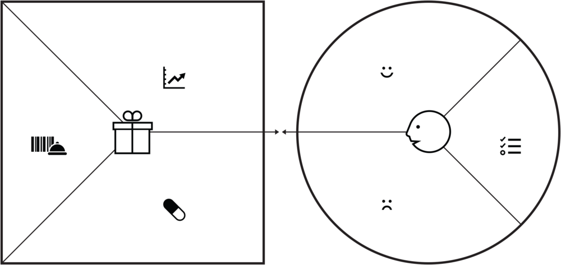
Value Proposition Canvas
It contains of two parts; the Value Map – the square on the left side, and the Customer Profile map – the circle on the right side. We are going to discuss about the customer profile map further.

Slide 20
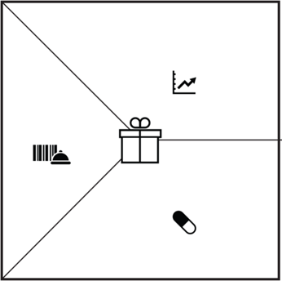
Gain Creators,
Products and Services,
and Pain Relievers
Gain Creators
Describe how the products and services create customer gains.
Products and Services
Show a list of all the products and services a value propositions built around.
Pain Relievers
Describe how the products (and services) alleviate customer pains.

Slide 21
Gain Creators
It describes:
How the products and services create customers gains.
Questions to be asked: Could your products/services ...
create savings that pleased customers? In term money, time and effort?
Produce outcomes your customers expect or that even better than what they have expected? By offering better quality, more on somethings, etc.
outperform current VP and delight the customers?
Make the customers’ life easier?
Create positive social consequences?
Do something specific that the customers have been searching for?
Fulfill a desire customers dream about?
Produce positive outcomes mathing the customers’ success and failure criteria?
Help make adoption easier? By offering lower cost, fewer investments, lower risk etc?

Slide 22
Pain Relievers
It describes:
How exactly your products and service alleviate specific customer pains.
Questions to be asked: Could your products/services ...
Produce savings?
Make your costumer feel better? By killing frustrations, annoyances, etc.
Fix underperforming solutions? By introducing new features, etc.
Put an end to difficulties and challenges that the customers encounter?
Wipe out negative social consequences or fear?
Elimitate risks that most customers worry about?
Help the customers have better sleep during the night?
Limit, or eradicate the common mistakes that customers make?
Eliminate barriers that are keeping your customers from adopting the new Value Propositions?

Slide 23
Products and Services
This is simply the part that the business offers.
Various types of VP:
Physical/Tangible – goods, such as manufactured products.
Intangible – Products such as copyrights or services such asafter-sales assistane.
Digital – productions such as music downloads or services such as online recommendations.
Financial – products such as investments funds and insurances or services such as the financing of a purchase.

Slide 24
Mapping the Value Proposition

Slide 25
Mapping the VP
Things to Remembers:
Remarkable Value Propositions focus on jobs, pains and gains that matter to customers and achieve those exceedingly well.
The whole – if possible – pains and gains of the customers should be addressed. Focusing on these would make some differences for the customers.

Slide 26
Mapping the VP
Gain creators highlight how exactly the products & services help customers achiave gain. Each gain creator addressed at least one of more pains or gains.
The list of the products and services that the value propositions builds on the specific customer segment.
Pain relievers outline how exactly the products & service kill customers pains. Each pain reliever addresses at least one or more pains or gains.

Slide 27
Mapping How the Products Create Value

Slide 28

The Objective
Giving the clear description, explicitly how the product and services create value

Slide 29





The Steps
List all products &
services of your existing value proposition.
Outline gain creators
Rank it all,
by order of importance.
Outline pain reliever.

Slide 30
Value Proposition Fit – Three Kinds of Fit

Slide 31
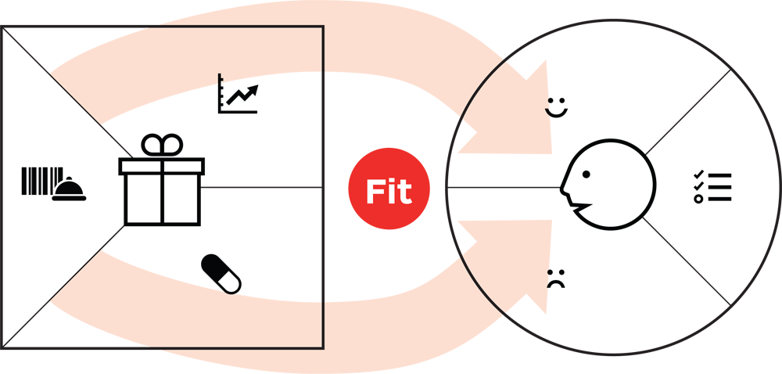
Fit
Customer expect & desire a lot from the products & services, so they also know they can’t have it all. Focus on the gains that matter most, and make the difference.
Are you addressing essential customer gains?
Are you addressing extreme customer pains?
Customer have a lot of pains. No organizations could address all of them, Focus on the headache that matter most and are insufficiently addressed.

Slide 32



Three Kinds of Fits
In the
Market
On-Paper
In the Bank
Problem-Solution Fit
It fits when you:
Have evidence that customers care about certain jobs, pains and gains.
Designed a value proposition that addresses those jobs and gains
No evidence that customer really care about your VP at this stage, not yet.
2. Problem-Market Fit
It fits when you:
Have evidence that the products and services, pain relievers and gain creators are actually creating customer value and getting traction in the market.
3. Business Model Fit
It fits when you:
Have evidence that your value proposition can be embedded in a profitable and scallable business.

Slide 33
References
Alexander O, Yves P, Greg B, and Alan S (2014), Value Proposition Design. John Wiley & Co, New Jersey. ISBN: 978-1-118-96805

